Slide 1

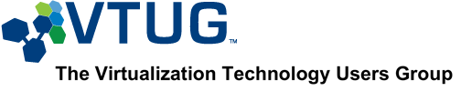
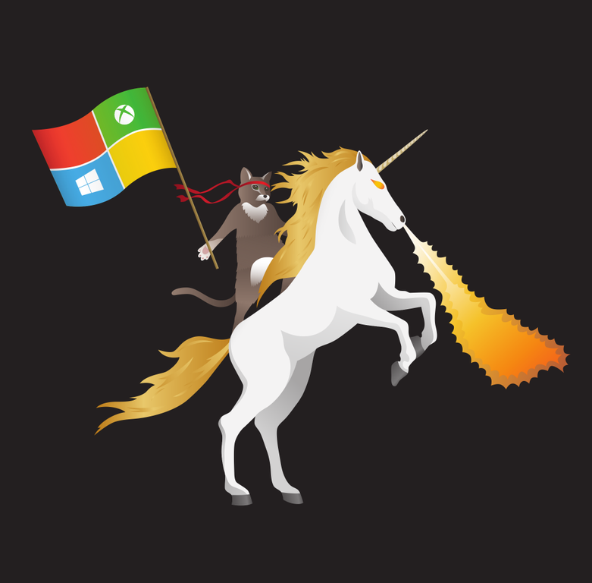
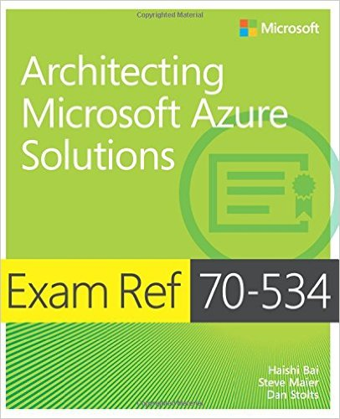



Windows Server 2016, Containers and Next Generation Micro Services
Dan Stolts (@ITProGuru) Chief Technology Strategist US DX North East – Audience Blog: ITProGuru.com
dstolts@Microsoft.com
www.linkedin.com/in/danstolts
aka.ms/70-534
Specializations:
Cloud, Virtualization, Windows Server
@ITProGuru
Notes:
Title: Windows Server 2016, Containers and Next Generation Micro Services
Abstract: Are you up to speed with the next HUGE WAVE of virtualization… containers and micro services? How will these great technologies impact our datacenters as they move into the mainstream with the soon to be released Windows Server 2016? Come to this session to have a look at the near future as well as the soon to be released tools to help us meet the demands of our businesses. On this journey, we will explore what and why of micro services and containers, how these new virtualization technologies will change our world and at what pace. We will show off some great new technologies built into Windows Server 2016 and get an understanding on how these new technologies will RAPIDLY change not only the virtualization landscape but also the cloud landscape.
Name of Presenter: Dan Stolts
Bio of Presenter (max 500 spaces): Dan Stolts “ITProGuru” is a technology expert who is a master of systems management and security. He is Chief Technology Strategist for Microsoft, owns several businesses and is a published author. Reach him on his primary blog http://itproguru.com or twitter @ITProGuru. He is proficient in many datacenter technologies (Windows Server, System Center, Virtualization, Cloud, Etc) and holds many certifications including MCT, MCITP, MCSE, TS, etc. Dan is currently specializing in system management, virtualization and cloud technologies. Dan is and has been a very active member of the user group community. Dan is an enthusiastic advocate of technology and is passionate about helping others. See more at: http://itproguru.com/about

Slide 2
Windows Server 2016, Containers and Next Generation Micro Services
Are you up to speed with the next HUGE WAVE of virtualization… containers and micro services? How will these great technologies impact our datacenters as they move into the mainstream with the soon to be released Windows Server 2016? Come to this session to have a look at the near future as well as the soon to be released tools to help us meet the demands of our businesses. On this journey, we will explore what and why of micro services and containers, how these new virtualization technologies will change our world and at what pace. We will show off some great new technologies built into Windows Server 2016 and get an understanding on how these new technologies will RAPIDLY change not only the virtualization landscape but also the cloud landscape.
Notes:
Name of Presenter: Dan Stolts
Bio of Presenter (max 500 spaces): Dan Stolts “ITProGuru” is a technology expert who is a master of systems management and security. He is Chief Technology Strategist for Microsoft, owns several businesses and is a published author. Reach him on his primary blog http://itproguru.com or twitter @ITProGuru. He is proficient in many datacenter technologies (Windows Server, System Center, Virtualization, Cloud, Etc) and holds many certifications including MCT, MCITP, MCSE, TS, etc. Dan is currently specializing in system management, virtualization and cloud technologies. Dan is and has been a very active member of the user group community. Dan is an enthusiastic advocate of technology and is passionate about helping others. See more at: http://itproguru.com/about

Slide 3
Datacenter inflection points
Containers - DevOps
Services – IaaS, PaaS, SaaS
Infrastructure hosting – early cloud
Machine Virtualization
Physical Machines

Slide 4
Containerization
ARM Template
2 Hosts
4 Instances of Container A
2 Instances of Container B
Container are… a technology that Enables and Accelerates DevOps
Abstract the unit of work from the VM
Lightweight, fast provisioning, density
Simplify application updates
Works with cluster managers for auto-scale capabilities
Container Host - 1
Container Host - 2
Container
A
Container
A
Container
A
Container
A
Container
B
Container
B
Orchestration Engine

Slide 5
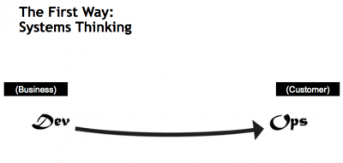
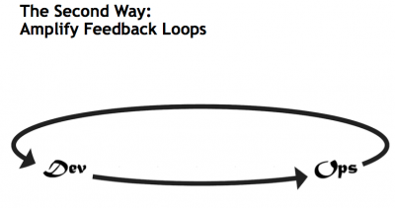
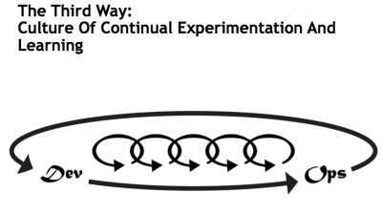
What is DevOps…
Infrastructure as Code (IaC)
Continuous Integration (CI)
Automated Testing
Application Performance Monitoring/Management (APM)
Continuous Deployment (CD)
Release Management
Configuration Management
DevOps Fundamentals
Advanced Monitoring
Capacity Management
Feature Flags
Self-Service Environments
Automated Recovery (Rollback & Roll-Forward)
Hypothesis Driven Development
Testing in Production – partial user base
Fault Injection
Usage Monitoring/Telemetry
A/B Testing (aka canary testing)
Gene Kim’s “3 ways”
The First Way emphasizes the performance of the entire system, as opposed to the performance of a specific silo of work or department — this as can be as large a division (e.g., Development or IT Operations) or as small as an individual contributor (e.g., a developer, system administrator).
The Second Way is about creating the right to left feedback loops. The goal of almost any process improvement initiative is to shorten and amplify feedback loops so necessary corrections can be continually made
The Third Way is about creating a culture that fosters two things: continual experimentation, taking risks and learning from failure; and understanding that repetition and practice is the prerequisite to mastery.
http://www.itproguy.com/devops-practices/
http://itrevolution.com/the-three-ways-principles-underpinning-devops/

Slide 6
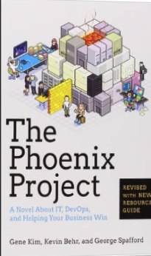
Tip: Must Read Book
Amazon…
The Phoenix Project: A Novel about IT, DevOps, and Helping Your Business Win Paperback
– October 16, 2014
The book is available on Audio Book; you can likely get it for free - if it’s your first time accepting a book from a friend. http://a.co/fJXE92A.
If you do not have an Audible Account, you get two free books when signing up for your free account.
This is the BEST IT Book I have ever read.

Slide 7
Traditional vs modern dev-ops
Category | Traditional | Modern DevOps
Quality of code check-ins | Unknown | Validated through unit tests
Environment Creation/Configuration | Manual | Automated
Deployment Frequency | 1-2 months (or less frequent) | Deploy whenever needed, including several per day
App Deployment Process | Requires meetings and planning | Push-button deployment
Deployment validation | Manual | Automated
Monitoring | Minimal to none | Health and Performance monitoring
Dev and Ops relationship | Blame culture | Culture of trust

Slide 8






Session VS VM (or VDI)
Single OS
All Workloads
OS, Apps, Config, Mgmt
EACH Workload
OS
OS
OS
OS
Apps
Apps
Apps
Apps
OS
OS
OS
OS
Apps
Apps
Apps
Apps
Massive Overhead
(Disk, Disk IO, Memory, CPU, OS, Licenses, The works)
OS
OS
OS
OS
workloads
Apps
Apps
Apps
Apps
OS
OS
OS
OS
Apps
Apps
Apps
Apps
Application(s)
Application(s)
Operating
System
Operating
System
Parent OS
Hardware Virtualization
Hardware Virtualization
Hardware / Hypervisor Level
Session Based Computing
VM or VDI Based Computing

Slide 9
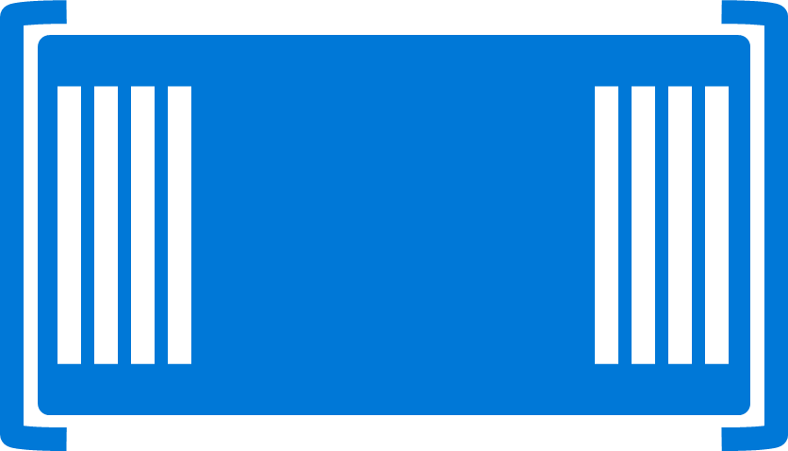
Containers
Single OS
All Workloads
OS
EACH Platform
App
App
App
App
App
App
App
App
App
App
App
App
App
App
App
App
App
App
App
App
App
App
App
App
All Advantages of VM & Session
Isolation, Little overhead
workloads
App
App
App
App
App
App
App
App
Container / Image
App
App
App
App
Container Engine
App
App
Linux VM
Container / Image
Container
Container
Application(s)
Container Engine
Container Engine
Operating
System
Operating
System
Parent OS
Hardware Virtualization
Hardware Virtualization
Hardware / Hypervisor Level
Session Based Computing Advantages
Container Based Computing VM Isolation

Slide 10

Container Run-time
Windows Server Containers
Host Operating System

Slide 11


Container Run-time
Windows Server Container(s)
Hyper-V Container(s)
Host Operating System
Virtual machine(s)
Hyper-V Hypervisor

Slide 12
Container Run-time
Windows Server Container(s)
Hyper-V Container(s)
Hyper-V Hypervisor
Host Operating System
Virtual machine(s)
Hyper-V Hypervisor

Slide 13
Container Run-time
Windows Server Container(s)
Docker / Other Container(s)
Container Engine
Host Operating System
Virtual machine(s)
Hyper-V Hypervisor

Slide 14
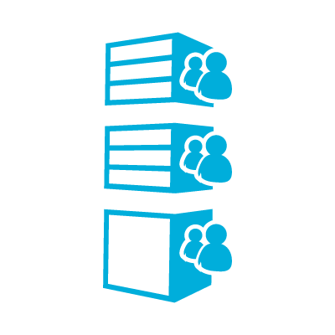


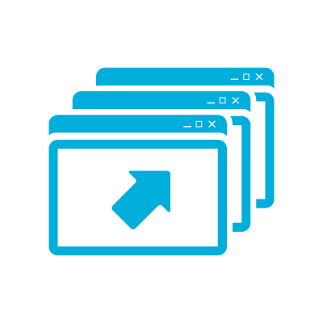


Microsoft’s Container Runtimes
Windows Server Container
HOSTING
HIGHLY AUTOMATED
SECURE
SCALABLE AND ELASTIC
EFFICIENT
TRUSTED
MULTI-TENANCY
Hyper-V Container
SHARED HOSTING
Regulated workloads
HIGHLY AUTOMATED
SECURE
SCALABLE AND ELASTIC
EFFICIENT
PUBLIC
MULTI-TEANCY

Slide 15

Thin Container Operating System Environments
Nano Server
Server Core
Highly Optimized
Highly Compatible
Born in the cloud applications
Traditional Applications

Slide 16



What is in A Container Image … and Creation
C:\nodeJS
Local Repository
Container View
Application
Framework
Sandbox
empty
C:\Windows\*
Container OS
Image
C:\Windows\*

Slide 17
Image Creation
C:\nodeJS
Local Repository
Container View
Application
Framework
Sandbox
C:\nodeJs
C:\Windows\*
C:\nodeJS
Container OS
Image
C:\Windows\*

Slide 18
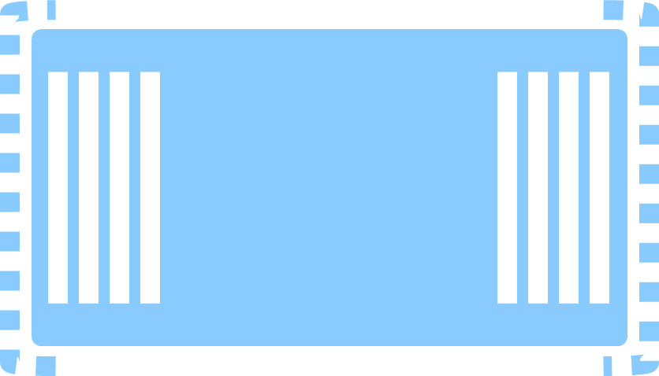
Image Creation
Local Repository
Container View
Sandbox
C:\nodeJs
Container OS
Image
C:\Windows\*

Slide 19
Image Creation
Local Repository
Container View
Application
Framework
Application
Framework
C:\nodeJs
Container OS
Image
C:\Windows\*

Slide 20
Image Creation
Local Repository
Sandbox
Empty
Container View
Application
Framework
Application
Framework
C:\nodeJs
C:\Windows\*
C:\nodeJS
Container OS
Image
C:\Windows\*

Slide 21
Image Creation
C:\myApp
Local Repository
Sandbox
Empty
Container View
Application
Framework
Application
Framework
C:\nodeJs
C:\Windows\*
C:\nodeJS
Container OS
Image
C:\Windows\*

Slide 22
Image Creation
C:\myApp
Local Repository
Sandbox
C:\myApp
Container View
Application
Framework
Application
Framework
C:\nodeJs
C:\Windows\*
C:\nodeJS
C:\myApp
Container OS
Image
C:\Windows\*

Slide 23
Image Creation
Local Repository
Sandbox
C:\myApp
Container View
Application
Framework
Application
Framework
C:\nodeJs
Container OS
Image
C:\Windows\*

Slide 24
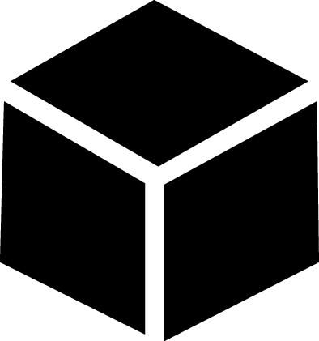
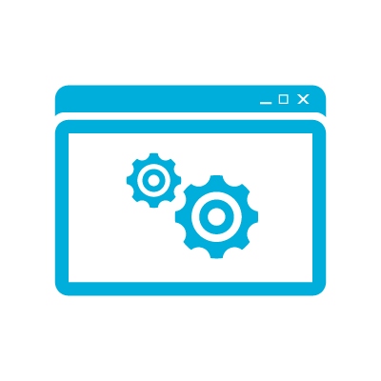
Image Creation
Local Repository
Application
Image
C:\myApp
Container View
Application
Framework
Application
Framework
C:\nodeJs
Container OS
Image
C:\Windows\*

Slide 25
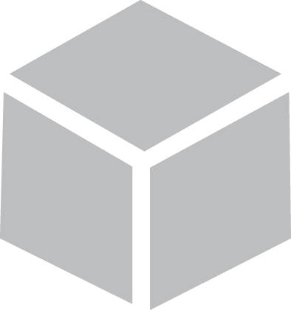
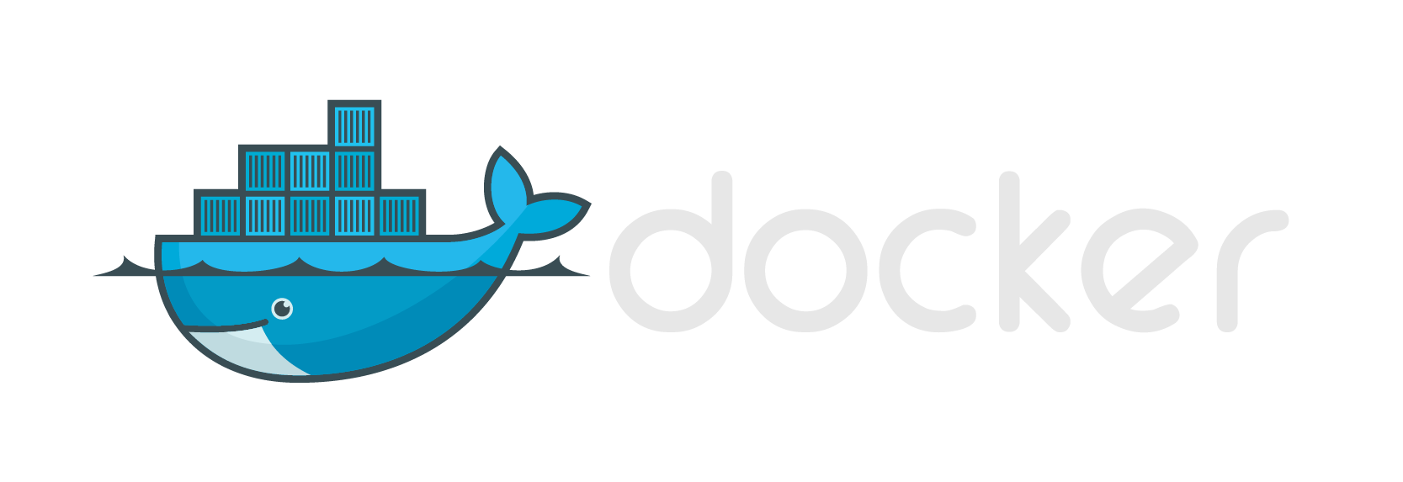


Modern App Development, Flexible Isolation
Windows Container Images
Container Run-Times
Container Management
Docker
Hyper-V Container
PowerShell
Application
Framework
Others
Windows Server Container
Write once, deploy anywhere

Slide 26
Monolith and Microservices
Evolution of an application
Application
Application
Feature
A
Feature
B
Feature
C
Feature
A
Feature
B
Feature
C
Refactor
Update frequency
Different scale reqs
Different technology
Size, etc.

Slide 27
DevOps & Monolithic vs Micro Services
Micro Services
Split Services into small pieces
Easily Scale, Deploy, code, etc.
Faster Execution
Higher Reliability
Faster MTTR mean time to repair
Agile capabilities
Automation Continuous Delivery
Amplify Feedback Loops
Monolithic
All Feature in Full App
Long Cycles (Dev, Test, Q/A, Deploy, update, etc.)
Error / Bug Prone
Expensive
Quick Fixes hard or impossible
More bottlenecks
Harder to test (more changes at once)
Application
Feature A
Feature C
Feature E
Feature B
Feature D

Slide 28
What’s the downside?
More services means more network communication
Decreases overall performance due to network hops & (de)serialization
Requires more failure (timeout) recovery code
Hard to test in isolation without dependent services
Hard to debug/monitor across services
New service versions must support old & new API contracts simultaneously because client services don’t upgrade at the same time
Devops persona trade short-term pain for long-term gain

Slide 29
Sample microservices application dev-ops flow using containers
Docker registry
flakio/s1
S1-Dev
S1-QA
S1-Prod
flakio/s2
S2-Dev
S2-QA
S2-Prod
Key points:
Each service has its own repo
Each service has its own CI/CD pipeline
Staged environments can be used but don’t have to (Testing in production)
flakio/s3
S3-Dev
S3-QA
S3-Prod
Dev Cluster
QA Cluster
Prod Cluster
Notes:
CI/CD = Continuous Integration/Continuous Deployment

Slide 30





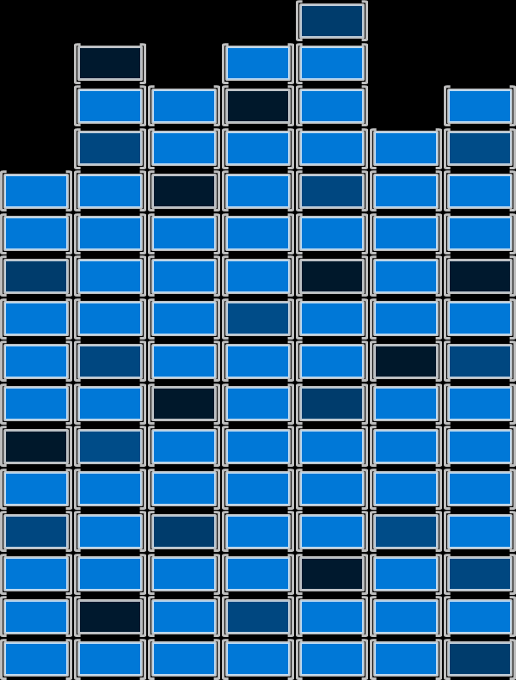
Dev/Ops Process with Containers
Developers update, iterate, and deploy updated containers
2
3
Operations collaborates with developers to provide app metrics and insights
Developers build and test apps in containers, using development environment i.e. Visual Studio
Operations automates deployment and monitors deployed apps from central repository
1
Central Repository
2
Containers pushed to central repository

Slide 31
Higher Level Services
User workload or service
Get and manage VM’s
Install task applications
Significant amount of infrastructure, not related to business
Manage and authenticate users
Start the tasks
Move task input and output
Queue tasks
IaaS or Cloud Service
Standard or custom images
Windows or Linux
Task failure? Task frozen?
Scale up and down
Cloud Services
IaaS
Virtual Machines
Commodity to high-performance
Small to huge
RDMA network for tightly coupled tasks
Hardware

Slide 32


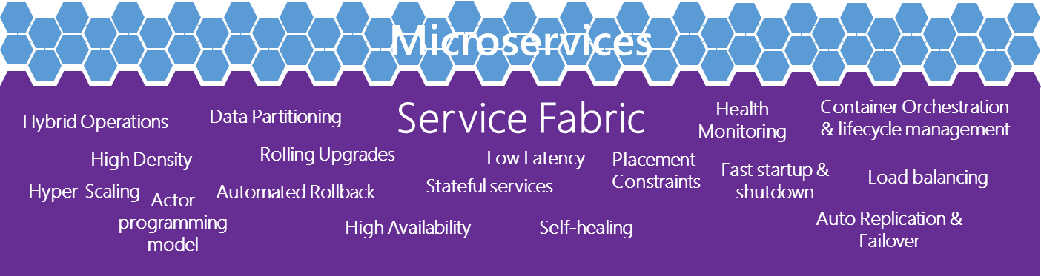
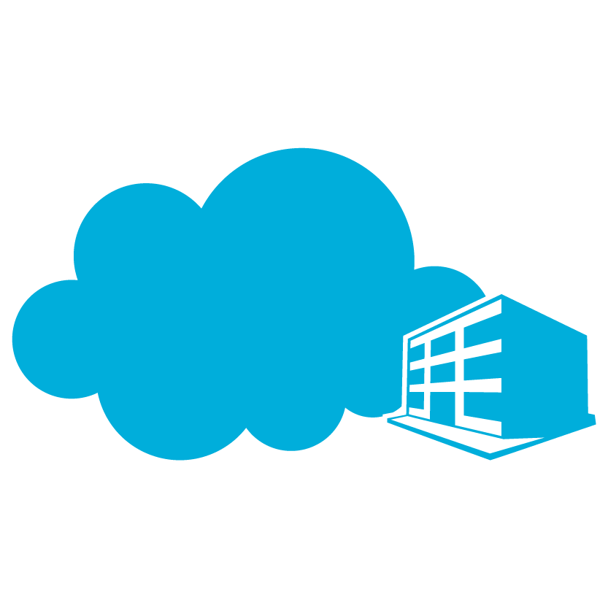

The right tools
Container Management
PowerShell
Docker
Others
Development Environments
Development Frameworks
and Languages
Virtual Machines / Container Technologies
Go
Perl
Linux
PHP
Phython
Node
JavaScript
.Net
C++
Ruby
Win32
Java
Others…
Service Fabric
Microsoft Cloud
Azure
On Premises
Service Provider

Slide 33

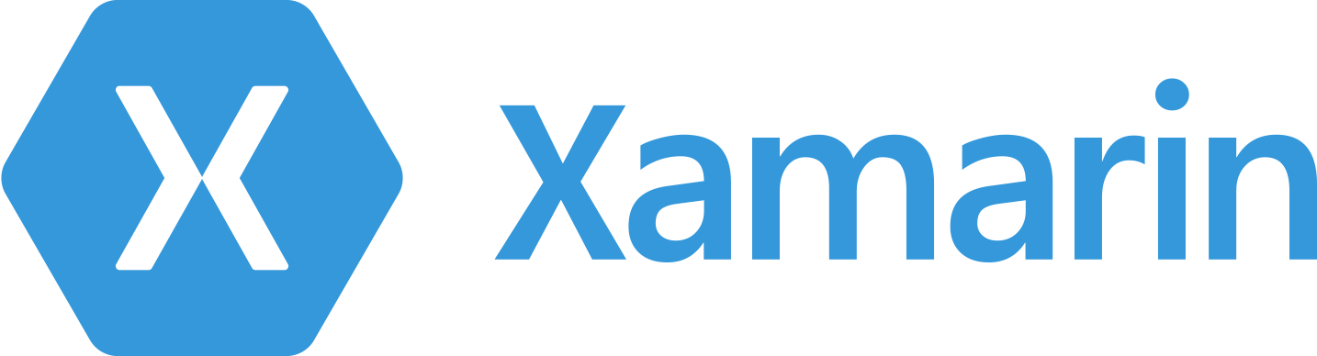
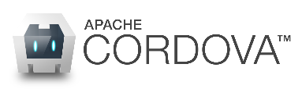


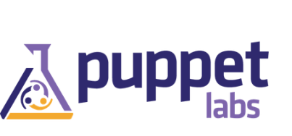

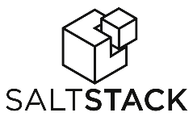







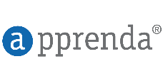
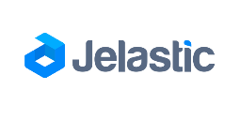
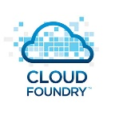
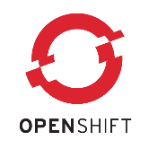
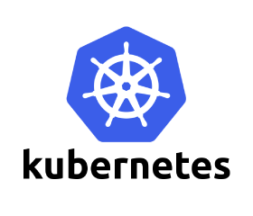
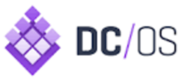
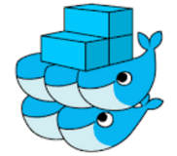

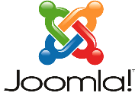


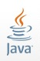

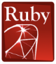








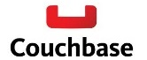






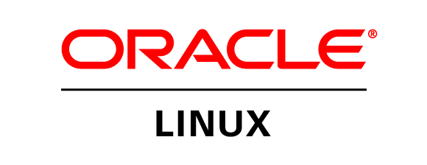
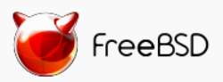

Azure is an open cloud
DevOps
Clients
Management
Applications
Orchestration
PaaS
App Frameworks
& Tools
Databases &
Middleware
Infrastructure

Slide 34
How Long Will it take to be mainstream?
Micro Services
3-5 Years
Many are now leveraging the processes
It will take time for applications to be rewritten using new technology
DevOps practices will dictate
As people learn about the massive capabilities of Agile, DevOps capabilities they will institute these changes but it will take time to change many apps
Cloud scale and cost savings could make it shorter (possibly even much shorter)
Containers
1-2 Years
Docker has already started driving this technology forward
No “coding” changes are needed so very fast adoption
Docker, Cloud providers and new Server OS are all making it easy and cost effective

Slide 35
Containers Offer
Fast Iteration
Resource Controls
Rapid Deployment
Defined State Separation
Immutability
(unchangeable)

Slide 36
Making Them Ideal For
Distributed Compute
Databases
Web
$$f\left(x\right)$$
Scale Out
Tasks

Slide 37
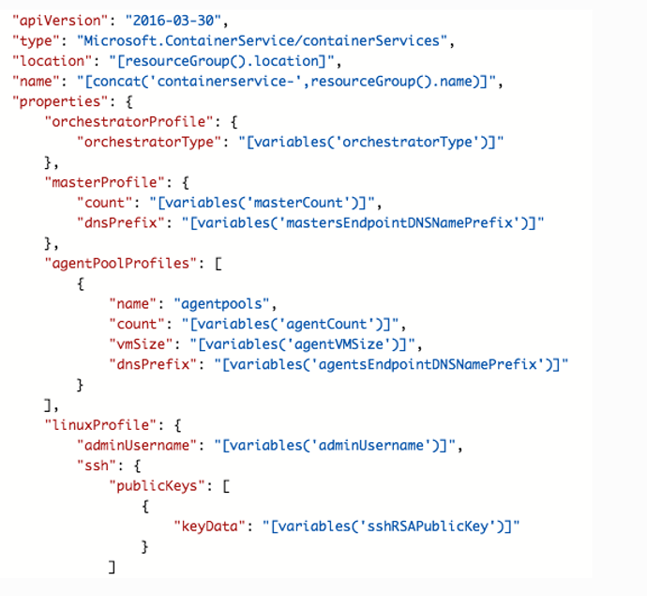
Azure Container Service Template
orchestratorProfile
masterProfile
agentPoolProfiles
linuxProfile

Slide 38
Learn more with FREE IT Pro Resources
Free technical training resources:
On-demand online training: http://aka.ms/moderninfrastructure
Free ebooks:
Deploying Hyper-V with Software-Defined Storage & Networking: http://aka.ms/deployinghyperv
Microsoft System Center: Integrated Cloud Platform: http://aka.ms/cloud-platform-ebook
Expand your Modern Infrastructure Knowledge
Get hands-on: Free virtual labs:
Microsoft Virtualization with Windows Server and System Center: http://aka.ms/virtualization-lab
Windows Azure Pack: Install and Configure: http://aka.ms/wap-lab
Join the IT Pro community:
Twitter @MS_ITPro

Slide 39
Free Resources for DevOps Practices
Optimize your DevOps practices & tools:
Get started on your DevOps journey: aka.ms/devops
Download the Forrester Infrastructure-as-Code whitepaper:
Complexity kills. Automate with Infra as code: aka.ms/iac_tlp
Accelerate your application delivery lifecycle
Technical resources for Practitioners:
Get access to free online training, evals and HOLs: aka.ms/devopsmva
Join the Community conversations:
Use #TalkDevOps on Twitter

Slide 40
Agenda/Objectives
Know
Gain
Learn
enough about containers to be dangerous
insights on where you would use containers
what Microsoft
is doing with containers

Slide 41
What’s Next?
Preview of Windows Server Containers – this summer.
Preview of Hyper-V Containers – planned for this year
How can you stay up to date?
Follow me on Twitter @ITProGuru
Follow my Blog http://ITProGuru.com
Windows Container’s site https://msdn.microsoft.com/virtualization/windowscontainers
http://aka.ms/windowscontainers

